Slide 1
VPC
Amazon Virtual Private Cloud (Amazon VPC) enables you to launch AWS resources into a virtual network that you've defined.
A virtual private cloud (VPC) is a virtual network dedicated to your AWS account. It is logically isolated from other virtual networks in the AWS Cloud.
A subnet is a range of IP addresses in your VPC.
You can launch AWS resources into a specified subnet. Use a public subnet for resources that must be connected to the internet,
private subnet for resources that won't be connected to the internet.
To protect the AWS resources in each subnet, you can use multiple layers of security, including security groups and network access control lists (ACL).

Slide 2
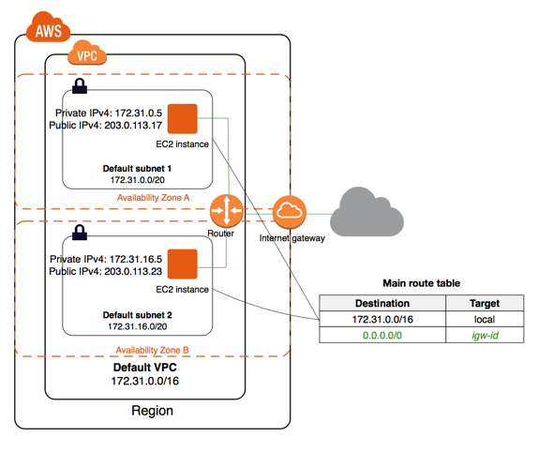

Slide 3
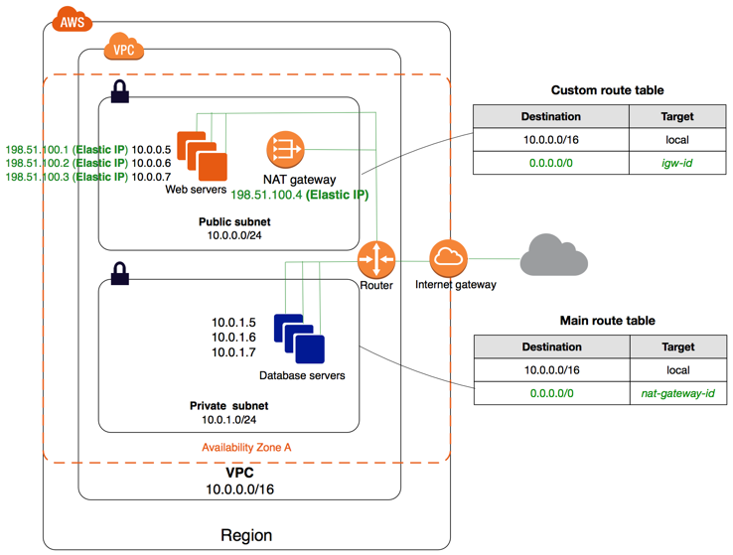
NAT Gateways:
You can use a network address translation (NAT) gateway to enable instances in a private subnet to connect to the internet or other AWS services.
You are charged for creating and using a NAT gateway in your account.
NAT gateway supports 5 Gbps of bandwidth and automatically scales up to 45 Gbps
You can associate exactly one Elastic IP address with a NAT gateway
NAT gateway supports the following protocols: TCP, UDP, and ICMP.

Slide 4
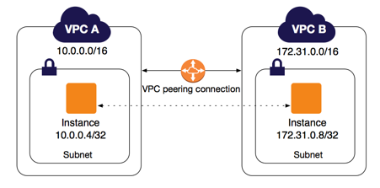
VPC Peering:
A VPC peering connection is a networking connection between two VPCs that enables you to route traffic between them using private IPv4 addresses or IPv6 addresses.
You can create a VPC peering connection between your own VPCs, or with a VPC in another AWS account.

Slide 5
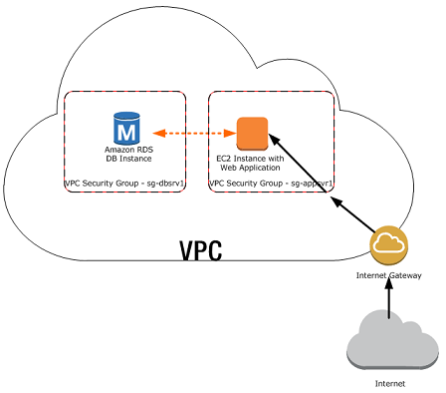
Security Groups:
A security group acts as a virtual firewall that controls the traffic for one or more instances.
When you launch an instance in a VPC, you must specify a security group that's created for that VPC.After you launch an instance, you can change its security groups.
AWS security groups (SGs) are associated with EC2 instances and provide security at the protocol and port access level.
limited to only 100 security groups per VPC.

Slide 6
AWS Security Groups: rules
By default, security groups allow all outbound traffic.
The actual rule set that filters traffic is made up of two tables: ‘Inbound’ and ‘Outbound’.
AWS Security groups are stateful, meaning you do not need the same rules for both outbound traffic and inbound.
Each rule is comprised of four fields: ‘Type’, ‘Protocol’, ‘Port Range’, and ‘Source’. This applies for both ‘Inbound’ and ‘Outbound’ rules.
Type: The drop down list allows you to select common protocols like SSH, RDP, or HTTP. You can also choose custom protocols.
Protocol: This is typically greyed out, as it’s covered by most ‘Type’ choices. However, if you create a custom rule, you can specify your protocol (TCP/UDP etc.) here.
Port Range: This value will also usually be pre-filled, reflecting the default port or port range for your chosen protocol. However, there might be times when you prefer to use custom ports.
Source: This can be a Network Subnet range, a specific IP address, or another AWS security group. You can also leave access open to the entire Internet using the ‘Anywhere (0.0.0.0/0)’ value.

Slide 7
Network ACLs (NACL):
A network access control list (ACL) is an optional layer of security for your VPC that acts as a firewall for controlling traffic in and out of one or more subnets.
ACLs monitor and filter traffic moving in and out of a network.
You can attach an ACL to one or more subnets within your Virtual Private Cloud (VPC).
If you haven’t created a custom ACL, then your subnets will automatically be associated with your VPC’s default ACL which ‘Allows’ all traffic to flow into and out of the network.
This is important, because ACL rules are read in ascending order
You can number of your rules starting at one (which will be read first), and going as high as 32766.
I would suggest that you leave a gap of at least 50 numbers between each of your rules (i.e., 50, 100, 150…) to allow you to more easily add new rules in sequence later, if it should be necessary.
ACLs, on the other hand, are stateless.
Therefore, when creating your rules, you may need to apply an outbound reply rule to permit responses to inbound requests.

Slide 8
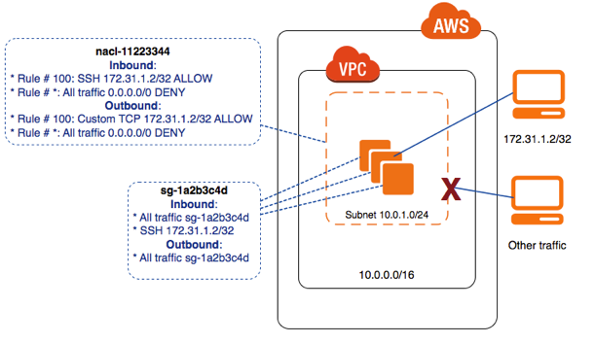

Slide 9
Let’s explain these fields:
Rule: As we mentioned, ACL rules are read in ascending order, but only until a rule matching the packet is found.
Care should be taken to number your rules appropriately when creating your rule base.
Type: This drop down list allows you to select from a list of common protocol types, including SSH, RDP, HTTP, and POP3. You can alternatively specify custom protocols such as varieties of ICMP.
Protocol: Based on your choice for ‘Type’, the Protocol option might be greyed out. For custom rules like TCP/UDP however, you should provide a value.
Port Range: If you do create a custom rule, you’ll need to specify the port range for the protocol to use
Source: This can be a network subnet range, a specific IP address, or even left open to traffic from anywhere (using this value: 0.0.0.0/0).
Allow/Deny: Each rule must include an action specifying whether the defined traffic will be allowed to pass or not.
When creating your ACLs be aware that there is a default limit of 20 inbound and 20 outbound rules per list.
You can associate a network ACL with multiple subnets; however, a subnet can be associated with only one network ACL at a time.
The highest number that you can use for a rule is 32766.
We recommend that you start by creating rules in increments (for example, increments of 10 or 100) so that you can insert new rules where you need to later on.

